Slide 1
Majority of the Faint (μJy) Radio Source Population Appears Powered by Star Formation, not AGN
Space Grant Intern: Liam Nolan
Mentor: Dr. Rolf Jansen

Slide 2
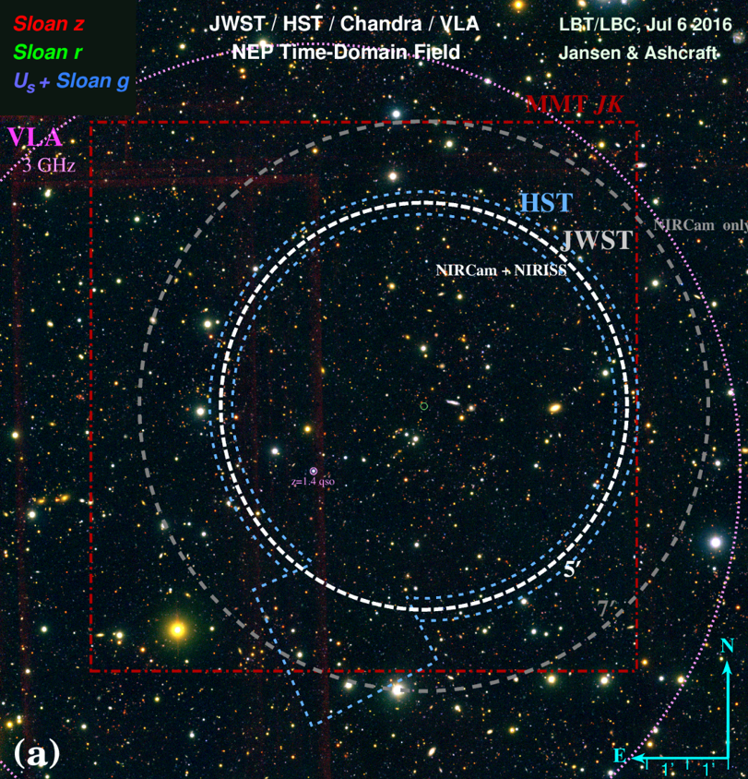
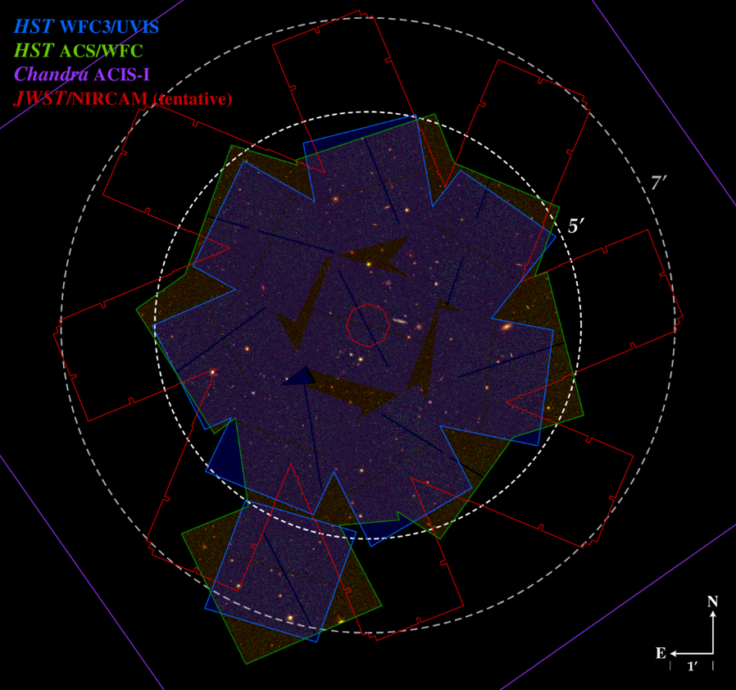
JWST and the North Ecliptic Pole Time-Domain Field
Planned start of JWST science observations in Spring 2022, including guaranteed time by R. Windhorst and team (GTO program #1176)
Survey of NEP TDF in 8 near-IR filters + slitless spectroscopy
Most suitable field for time-domain studies
Visible year-round
Low zodiacal foreground
Devoid of NIRCam-blinding sources
Important to undertake significant background study on field
X-ray through long-wave radio observations in hand or under way
Deep VLA 3GHz (~10cm) radio continuum observations

Slide 3
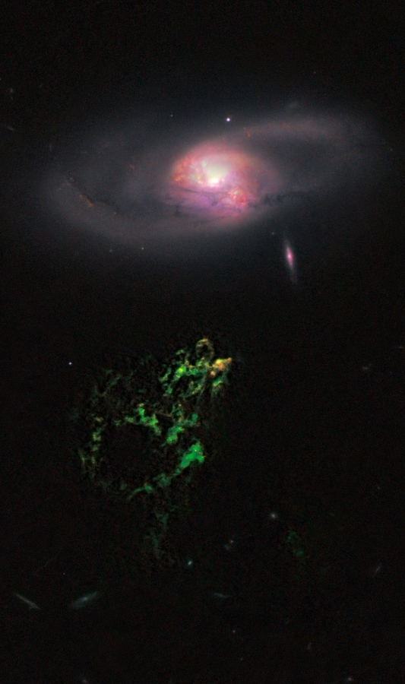
Faint Radio Source Population
What powers this population?
Assumed to be primarily star-forming, with ~10% AGN, but not confirmed
Far-IR observations lacking in field, req. large-aperture cryogenic space mission
If proportion of star-formation to AGN holds, promising for use of radio data in lieu of more difficult FIR
Ground-based instead of space-based
Credit: NASA APOD
Notes:
Image location: https://apod.nasa.gov/apod/ap110210.html

Slide 4
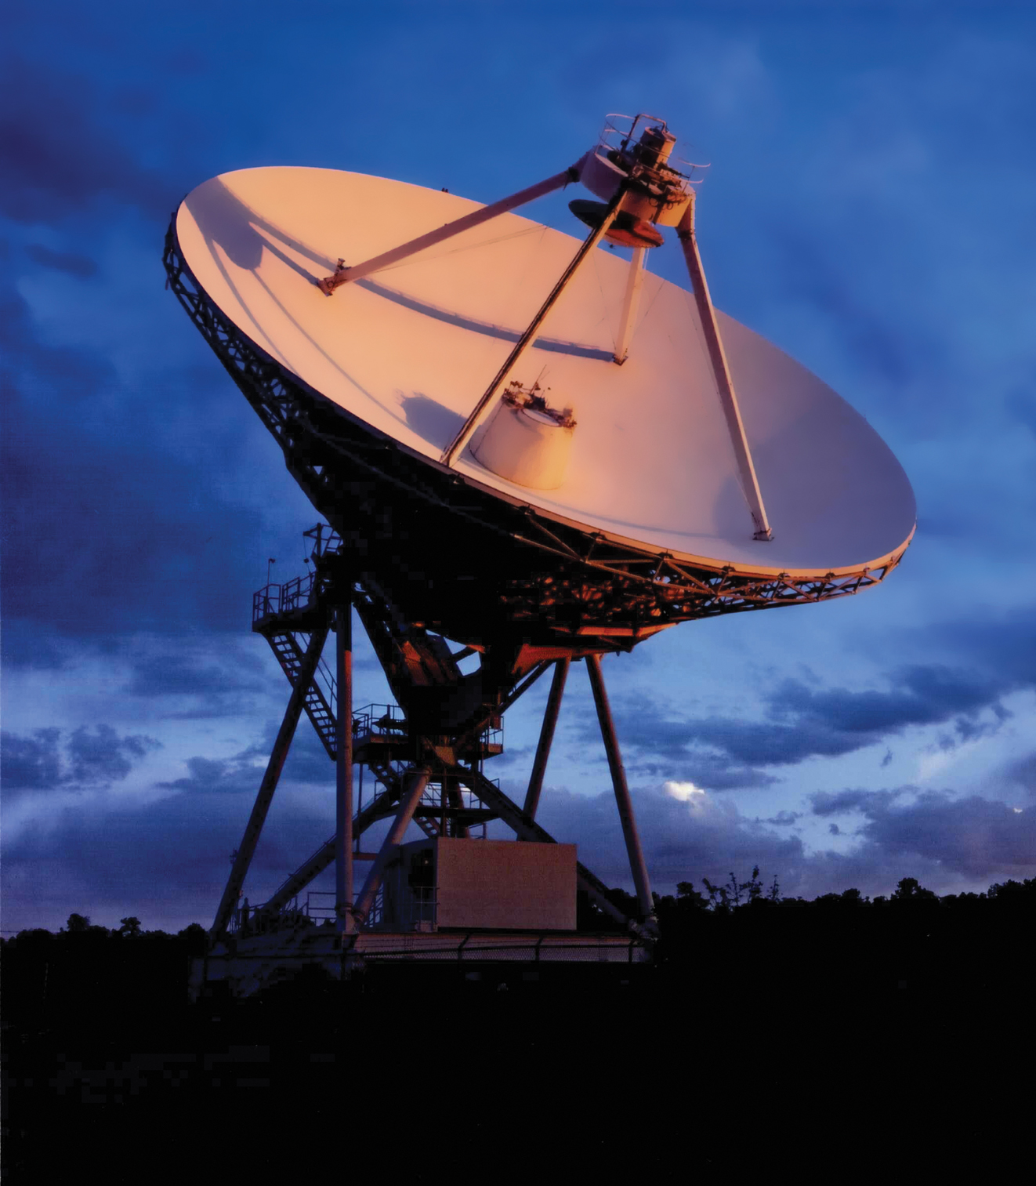
Very Large Array & Very Long Baseline Array Observations
Credit: NRAO/AUI/NSF
Notes:
Image locations: https://public.nrao.edu/gallery/sunrise-at-the-vla/
https://public.nrao.edu/gallery/red-sky-in-morning/

Slide 5
Available Data
~47 hrs. of jVLA 3 GHz observations in B and A configuration (PI: Windhorst)
Depth of ~0.9 μJy (4$σ$) at ~1” resolution (FWHM)
~147 hrs. of VLBA 4.8Ghz long-baseline radio observations (PI: Brisken)
Depth of ~20 μJy (6$σ$) at ~3 mas resolution (FWHM)
Seek patterns in near-IR and visible images for AGN signature, i.e. central point source or color
LBT/LBC Ugiz (PI: Jansen)
HST WFC3/UVIS F275W + ACSWFC F435W+F606W (PI: Jansen)
MMT/MMIRS YJHK (PI: Wilmer)

Slide 6
Methods: Differentiating Between Star-Formation and AGN
VLA detects a variety of sources due to its relatively coarse resolution
Identifies locations for object pointings
VLBA is only sensitive to near-point source emission
Emission from SF sources are extended throughout galaxy, AGN produce most to all of emissions from the galaxy center
Further and more accurate differentiation requires UV/Visible/NIR
Mixed cases (i.e. SF + weak AGN)
Object confusion (off-centered point sources)

Slide 7
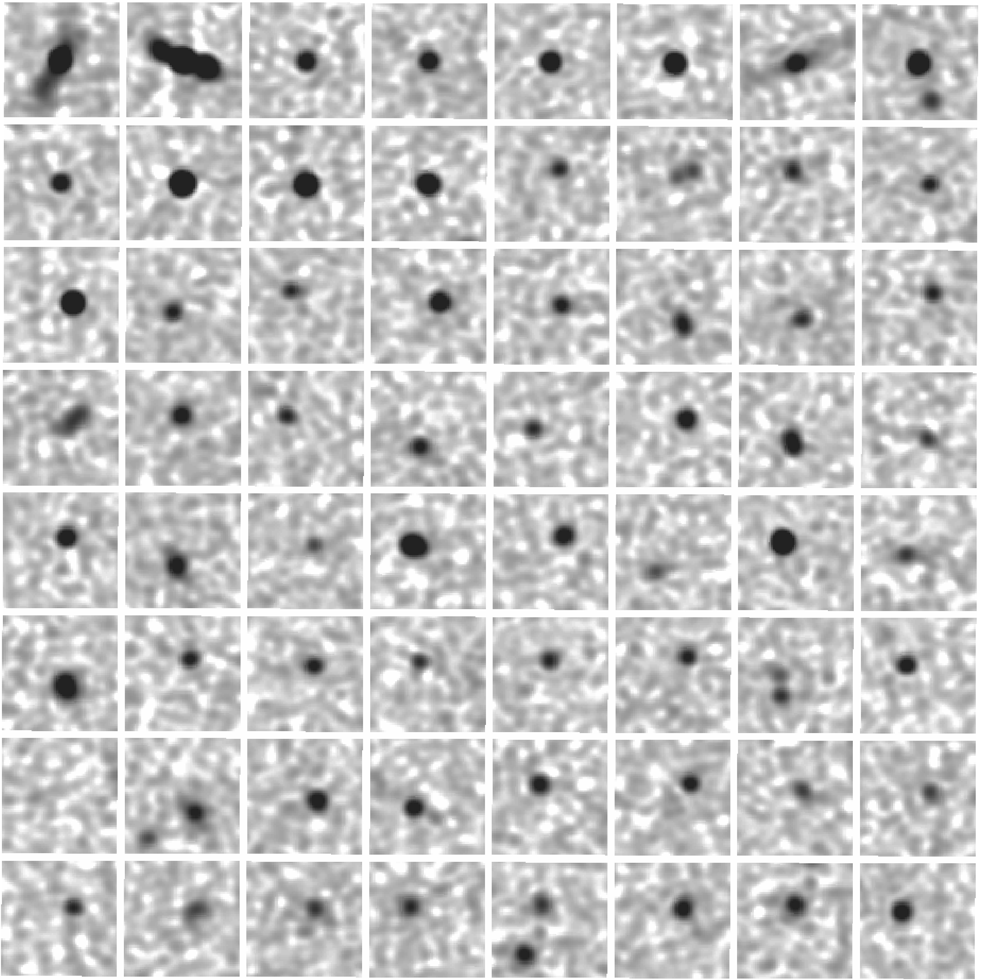
Results
Excised 64x64 pixel “postage stamps” of all ~2500 VLA-detected sources
Preliminary results show 12 VLBA detections at >18 μJy of ~130 VLA sources targeted
Created color composites for VLBA-detected sources and a comparison set of non-detections
Excised 136x136 (~5” square) pixel stamps from HST images where available
Others are 30x30 (~5” square) pixel stamps from LBT/LBC images

Slide 8
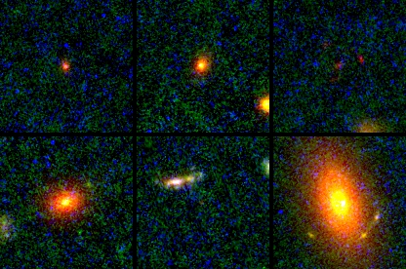
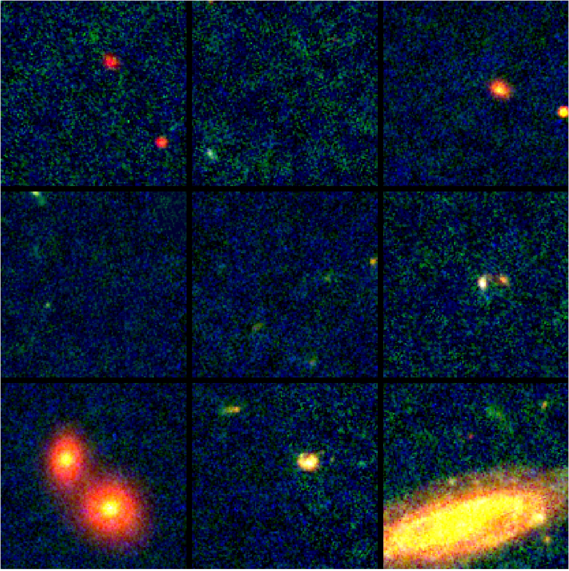
Results: Visible Composites
VLBA-detected, HST
VLBA non-detected, HST
VLBA-detected, LBC

Slide 9
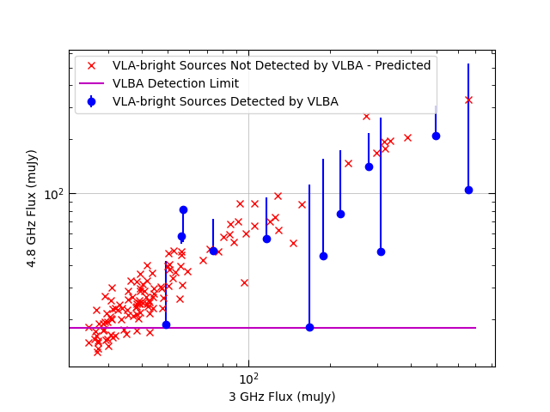
Results: Flux Predictions
Used spectral slopes across 2–4GHz bandpass (from W. Cotton) to predict 4.8 GHz flux of detected and non-detected VLA sources
Compared to actual measurements for detected sources
Compared to detection limit for non-detected sources
100+ sources with predicted flux above detection limit – definitively not powered by AGN!
Distribution consistent with predicted ratio of ~10% of AGN-powered galaxies
The Radio-FIR relation holds for the bulk of the faint (μJy) radio source population
500
300
70
50
30
30
50
70
300
500
800

Slide 10
Acknowledgements & Thanks
Data
R. Windhorst (ASU), R. Jansen (ASU), B. Cotton (NRAO), W. Brisken (NRAO), J. Gelfand (NYU), A. Matthews (UVA), C. Wilmer (UofA), W. Maksym (CfA),
R. Wrzosek (NYU), T. Ashcraft (ASU).
Thanks
R. Windhorst, S. Cohen, B. Joshi (ASU)
…and of course Dr. Rolf Jansen and the ASU/NASA Space Grant

